Slide 1
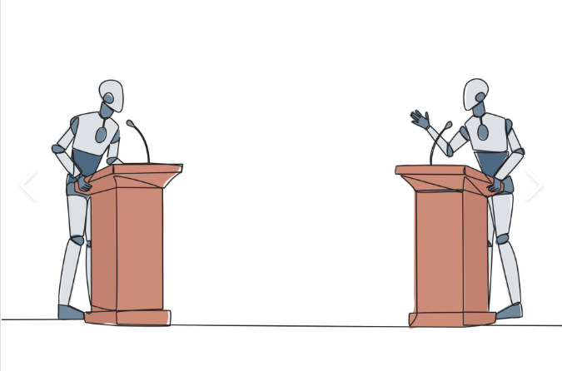
Multi-Agent Fault Tolerance through AI Debate
Joshua Jimenez & Gaurav Gupta

Slide 2
Objective
Utilize communication/discussion between multiple AI agents to improve sensor failure detection

Slide 3
What we will do
Evaluate the cost/benefit of the AI models in terms of successful error correction vs time taken.
Basically, determine if the agents are improving the ability for error detection and if the time taken by debate is worth the efficiency gain

Slide 4
Baseline
SensorLLM will be the baseline we will compare to.
We’ll be testing how effective this system is at making corrections on its own while also measuring execution time each trial. We’ll use this as a “control” group to compare against a multi-agent environment .

Slide 5
Code
https://github.com/JimenezJK16/Modern-Distributed-Midterm-Project

Slide 6
Next steps
Finalize a reliable method of determining consensus between agents
Utilize a larger number of agents
Utilize more sensor datasets
Increased testing, with more statistical data collected
Organize our findings into a report

